Slide 1

t
The Finals
Elite Four Project

Slide 2
Video
About
Problem
Project
UML
Next Steps
RPReplay_Final1675395992.mov

Slide 3
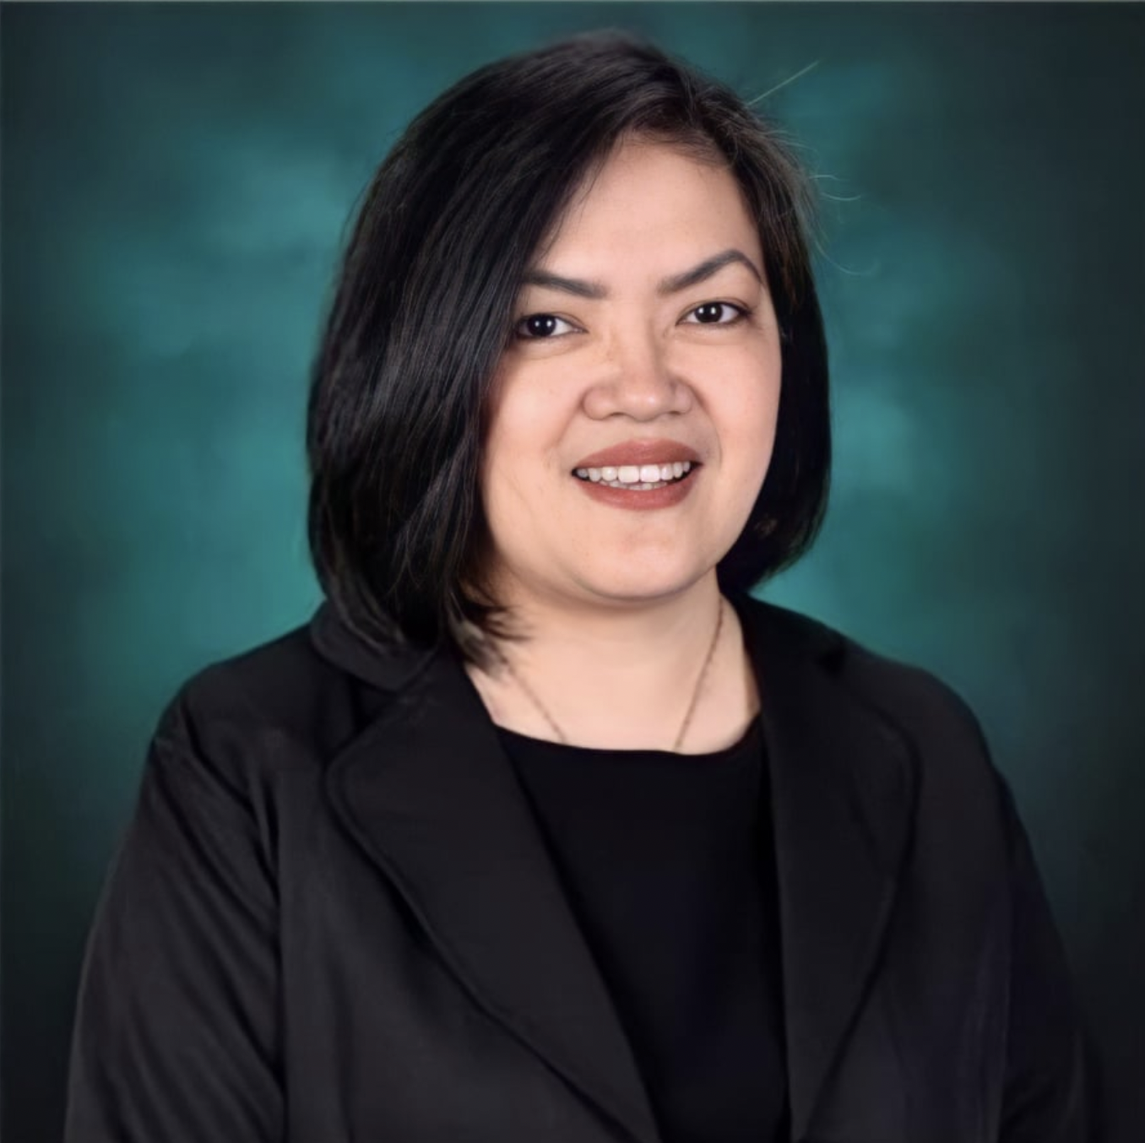
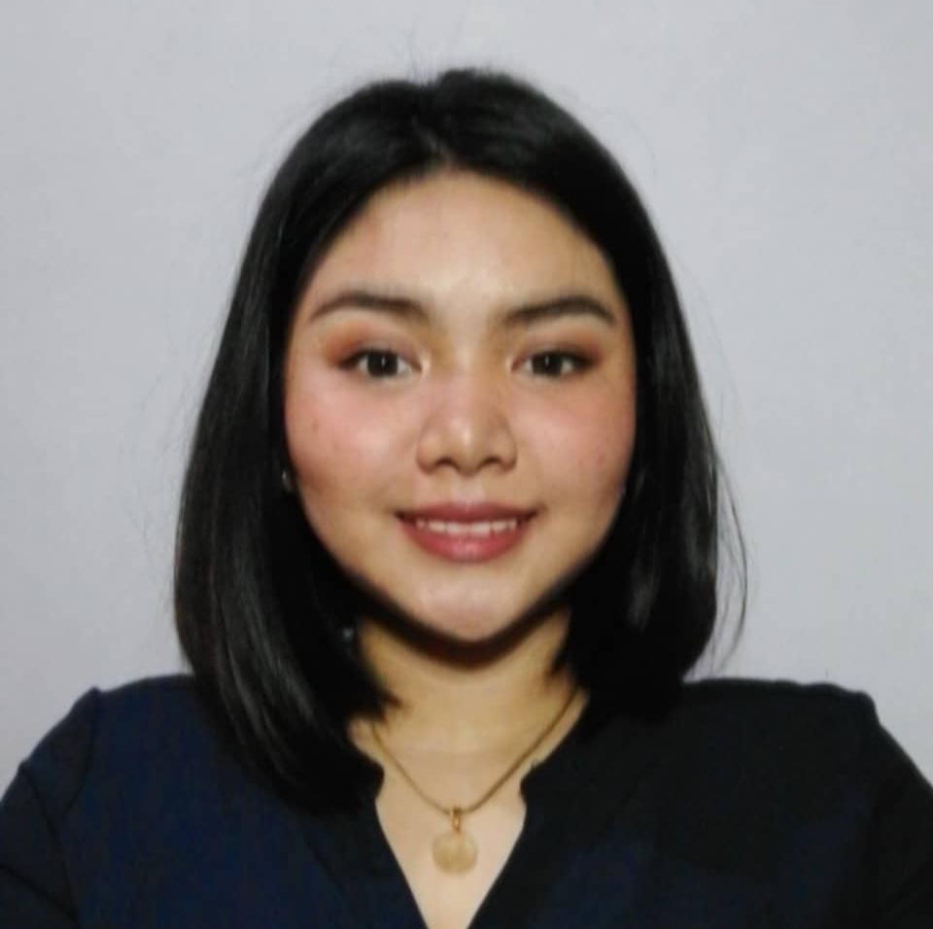

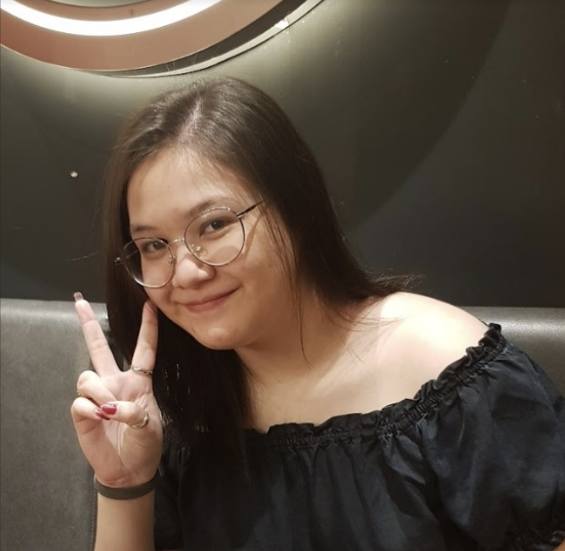


About
re-defense
Problem
Project
UML
Next Steps
RPReplay_Final1675395992.mov
Jo Anne M. de la Cuesta
Project Adviser
Alyssa L. Garcia
FrontEnd
Roselle Wednesday Gardon
Project Consultant
Andre O. Viernes
Francesca Erin R. Camino
Team Leader | Scrum Master
Stakeholder
Dan Michael C. Alfaras
Product Owner | Lead Developer

Slide 4
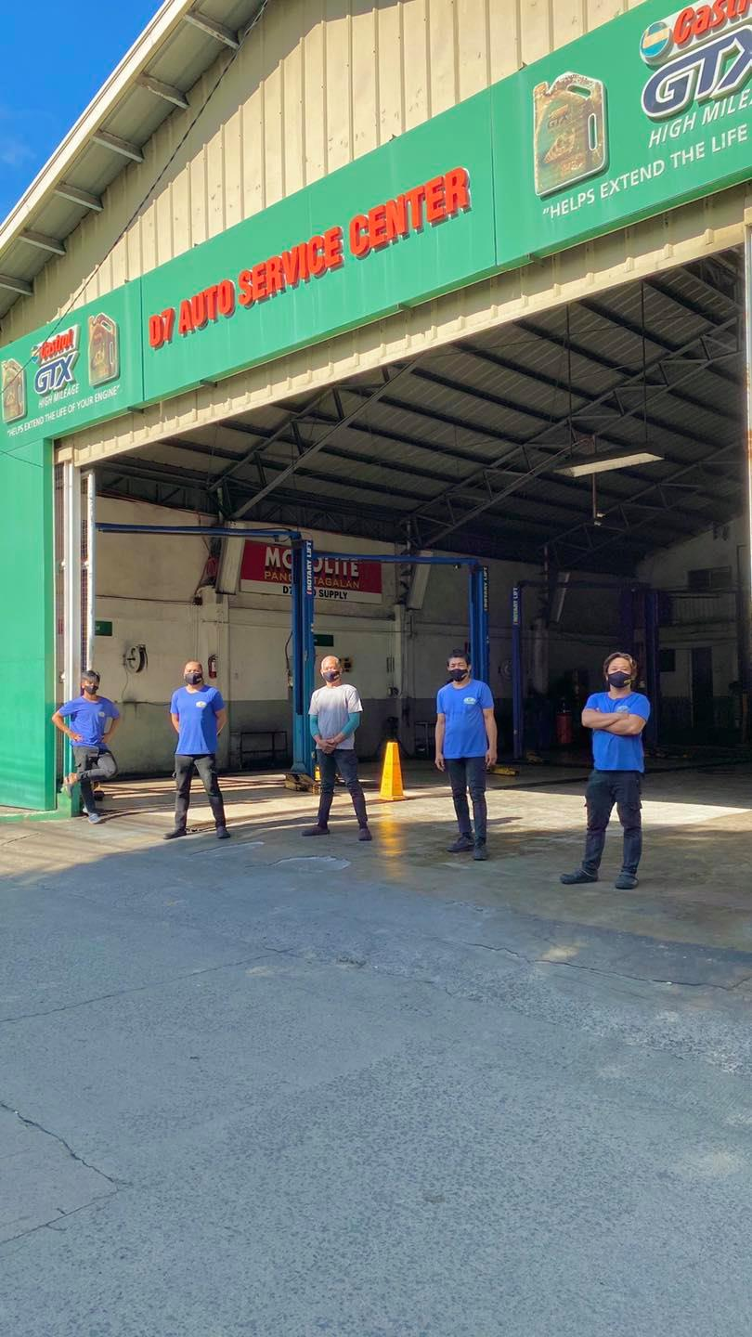

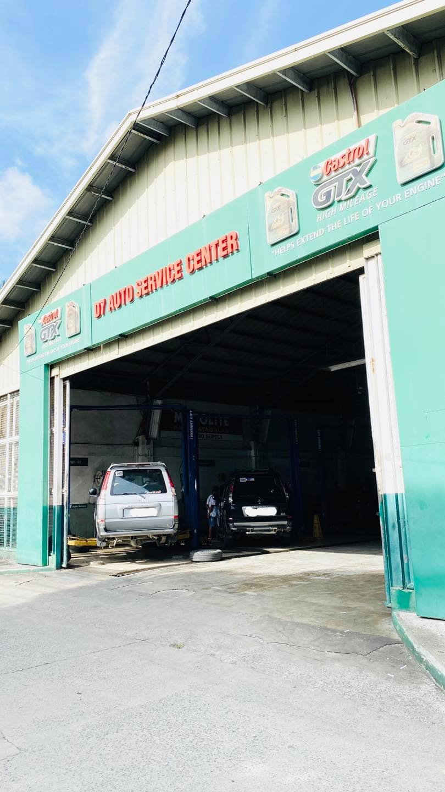
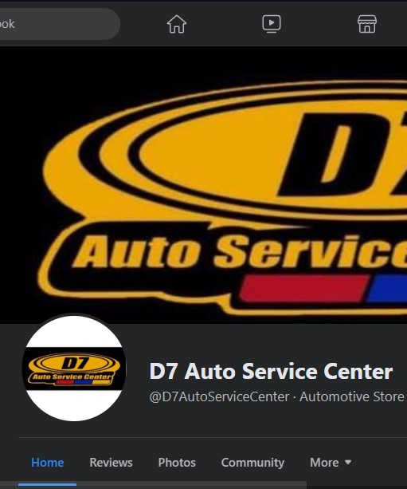
Video
About
Problem
Project
UML
Next Steps
RPReplay_Final1675395992.mov
D7 Auto Service center Background
Automobile Repair
Industry
FB as
Platform &
onsite services
D7 Auto
Service Center
Anne Sydney
Simpelo
16 years in
the industry

Slide 5

Video
About
Problem
Project
UML
Next Steps
RPReplay_Final1675395992.mov
What is the current system
D7 Auto Service center?

Slide 6
Video
About
Problem
Project
UML
Next Steps
RPReplay_Final1675395992.mov
D7 Auto Service center Background
Uploading
Posts
Management takes photos of servicing
Management posts the photos and services
Jo Anne M. de la Cuesta
Project Adviser
Answering
Inquiries
Checks for customer inquiries on Facebook
Responds to customer inquiries on Facebook
Alyssa L. Garcia
Lead Developer
Roselle Wednesday Gardon
Service Reservation
Accepts reservation request on-site
and through FB messenger, texts, onsite booking
Project Consultant
Andre O. Viernes
Francesca Erin R. Camino
Team Leader | Scrum Master
Stakeholder
Dan Michael C. Alfaras

Slide 7

Video
About
Problem
Project
UML
Next Steps
RPReplay_Final1675395992.mov
What is the problem of
D7 Auto Service Center?

Slide 8

Video
About
Problem
Project
UML
Next Steps
RPReplay_Final1675395992.mov
What is the problem of D7 Auto Service Center?
D7’s competitors continue to rise around the area, and even online.
A lack of centralized system for the reservation processes.
D7 Auto Service Center is experiencing difficulties in the advertising and building of online presence in their current system.
Troubled with ideas of how they may create more rapport with their customers, and potential clients.
Troubled in catching up with the ways, competitors are doing to standout.

Slide 9

Video
About
Problem
Project
UML
Next Steps
RPReplay_Final1675395992.mov
How can the Elite Four be of help to D7?

Slide 10

vEnsuring that the additional platform will also have functionalities that will help D7, not only in building online presence, and advertising, but also in managing their business, to maximize what they can do in the new platform!
Ensuring that the additional platform will also have functionalities that will help D7, not only in building online presence, and advertising, but also in managing their business, to maximize what they can do in the new platform!
Video
About
Problem
Project
UML
Next Steps
RPReplay_Final1675395992.mov
How can the Elite Four be of help to D7?
.
Specific Objectives
Main Objective
The Elite Four’s objective for D7 Auto Service Center is to provide a solution that caters their need to expand their online presence, their long-term concern with regards to managing their reservations​, as well as their struggle with regards to customer engagement ideas
To increase D7’s visibility and credibility by leveraging an additional online platform, to increase customer reach by up to 50% within the first three months of the web-app.
To develop a centralized system for D7 to manage the bookings of their customers and allow their customers to request reservations 24/7.
To extend the Auto Service Center’s support to their customers, as well as to their potential customers, through an environment that also promotes engagement with D7 to the public.

Slide 11

t
t
Live Chat
Bot Chat
t
t
Services Listing
Support Tab
t
Open the project for d7?
YES NA YES
t
t
Gallery & Reviews
Online Booking
t
t
360 Virtual Tour
Promotions
RPReplay_Final1675395992.mov
D7 Auto Service Center
Web-Application

Slide 12
t
Open the project for d7?
YES NA YES
RPReplay_Final1675395992.mov
t
t
Services Listing
Support Tab
t
t
Gallery & Reviews
Online Booking
t
t
360 Virtual Tour
Promotions
D7 Auto Service Center
Web-Application

Slide 13
t
Live Chat
t
t
Services Listing
t
t
Gallery & Reviews
Online Booking
t
t
360 Virtual Tour
Promotions
RPReplay_Final1675395992.mov
t
Significance of the Project
The project will be of great help in building online presence and value to the business of D7 Auto Service Center, while it also adds helps in managing bookings, monthly performance statistics, and responding to inquiries to be all in one place.
Addresses SDG no. 9
D7 Auto Service Center
Web-Application
Significance
of the Project

Slide 14
t
Live Chat
t
t
Services Listing
t
t
Gallery & Reviews
Online Booking
t
t
360 Virtual Tour
Promotions
RPReplay_Final1675395992.mov
t
References:
Image by <a href="https://www.freepik.com/free-vector/realistic-liquid-marble-background-with-gold_13118034.htm#page=3&query=marble%20background%20gold&position=5&from_view=search&track=ais">Freepik</a>
<a href="https://www.freepik.com/free-vector/curiosity-people-concept-illustration_30576696.htm#query=question&position=4&from_view=search&track=sph">Image by storyset</a> on Freepik
<a href="https://www.freepik.com/free-vector/man-thinking-concept-illustration_20824309.htm#query=man%20thinking&position=1&from_view=search&track=ais">Image by storyset</a> on Freepik
<a href="https://www.freepik.com/free-vector/www-concept-illustration_8426454.htm#query=website&position=1&from_view=search&track=sph">Image by storyset</a> on Freepik
<a href="https://www.freepik.com/free-vector/solidarity-concept-illustration_14562369.htm#query=group&position=8&from_view=author">Image by storyset</a> on Freepik
<a href="https://www.freepik.com/free-vector/hand-drawn-colorful-innovation-concept_20286053.htm#query=brainstorming&position=2&from_view=search&track=sph">Image by pikisuperstar</a> on Freepik
D7 Auto Service Center
Web-Application
Vector References

Slide 15
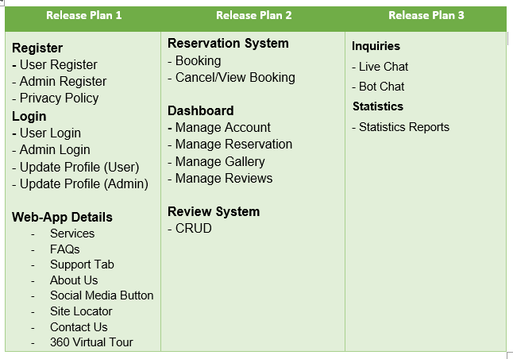
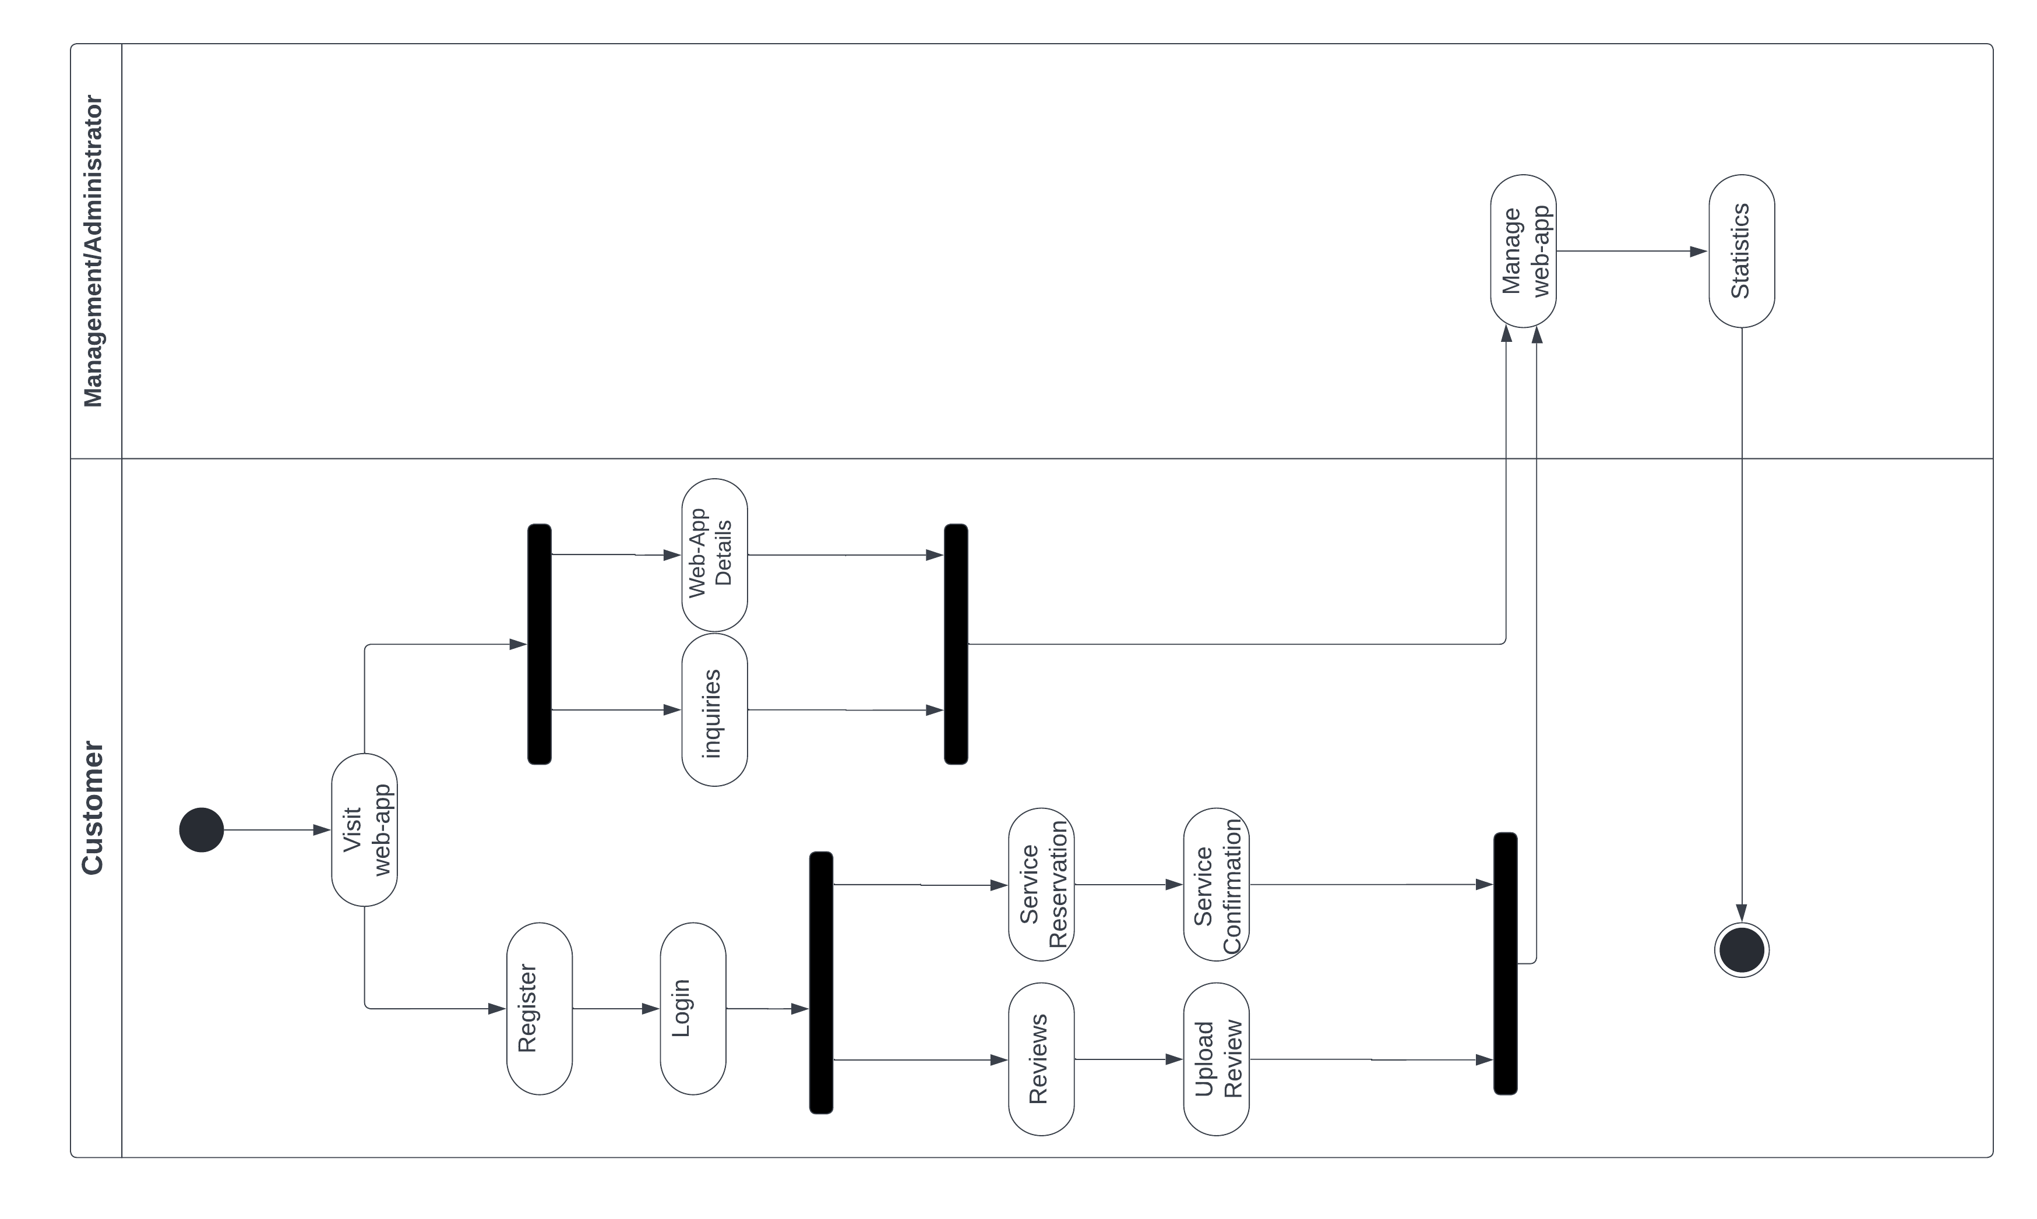
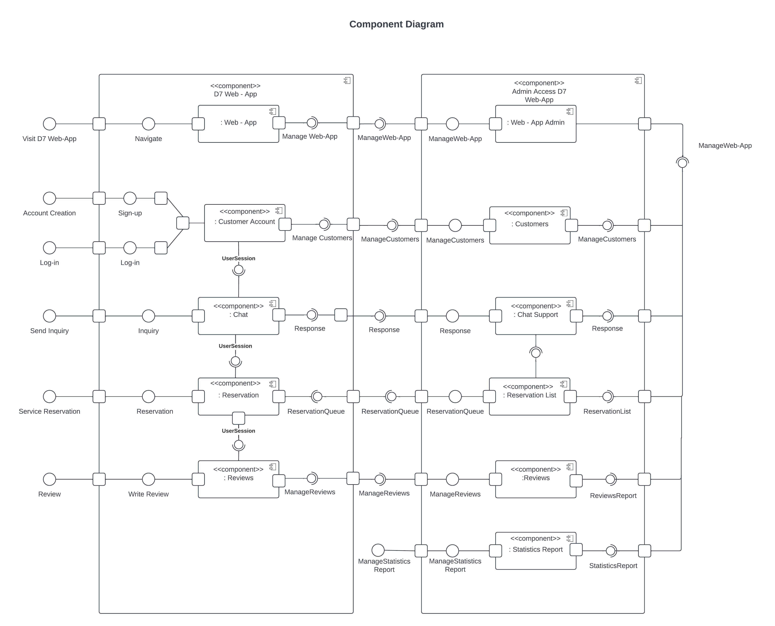
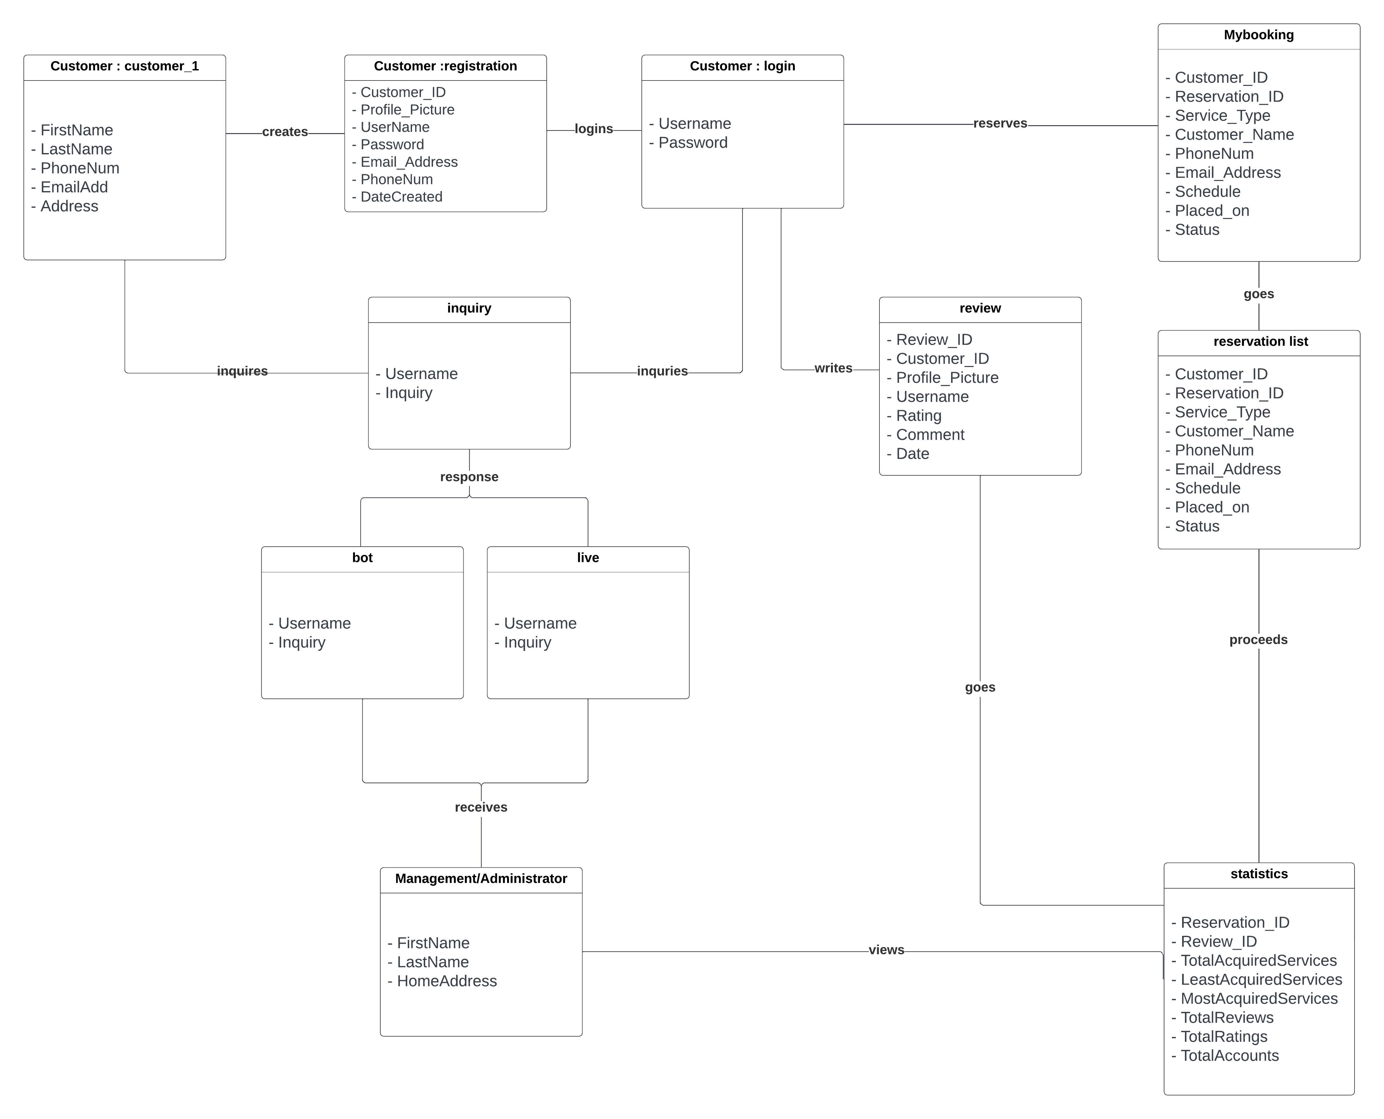
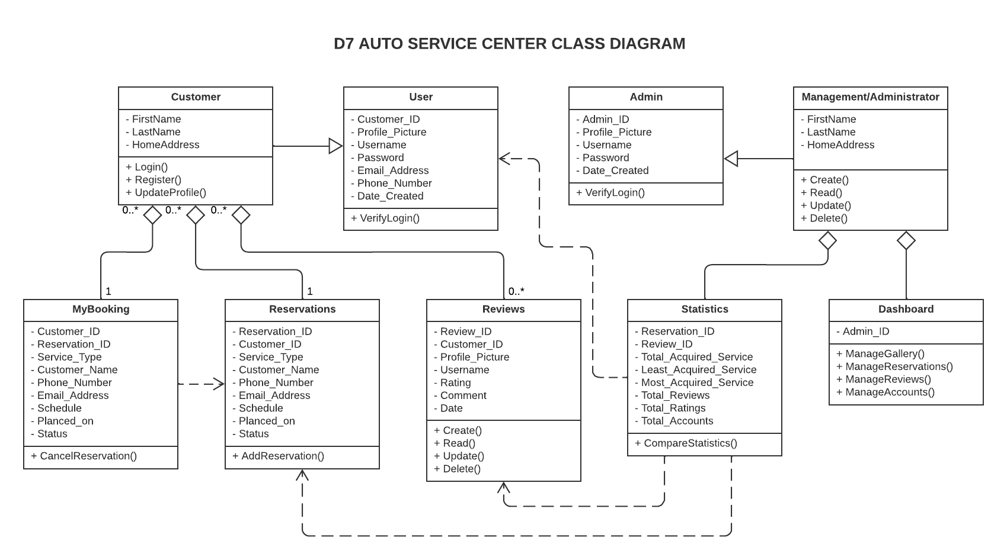
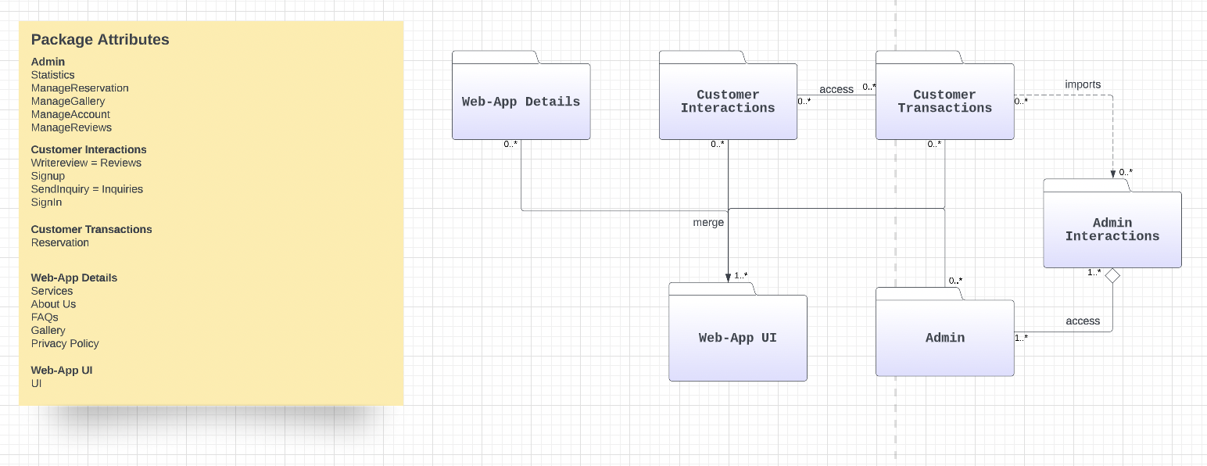
t
t
t
t
t

